Slide 1
Matlab程式設計_3_9
助教:金郁善

Slide 2
Anonymous funtion
A =@(x,y) x.^2+y.^2;
A1 = A(5,6);
A1 = 5.^2+6.^2;

Slide 3
Ex1:
a = 1.3;
b = .2;
c =30;
par = @(x) a*x.^2 + b*X + c; -> function handle
x=1;
y= par(x);

Slide 4
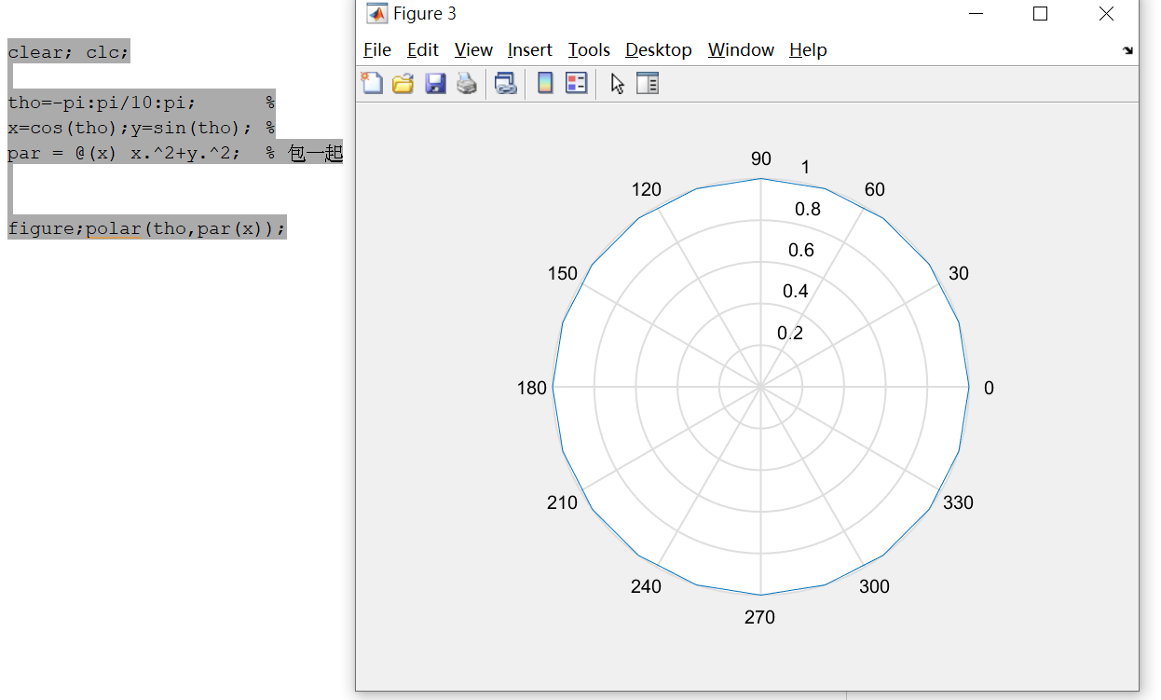

Slide 5

integral
Numerical integration
q = integral(fun,xmin,xmax)
g = @(c) (integral (@(x) (x.^2 +c*x +1),0,1));

Slide 6
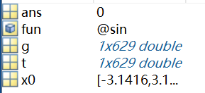
fzero
Root of nonlinear function
x = fzero(fun,x0)
tries to find a point x where fun(x) = 0.
clear;close all;clc;
t= -pi :0.01:pi;
g=sin(t);
x0 =[-pi pi];
fun = @sin;
ans = fzero(fun,x0);
plot(t,g);

Slide 7
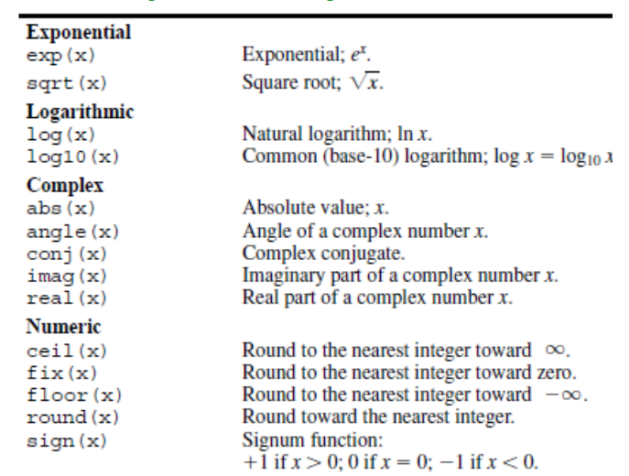
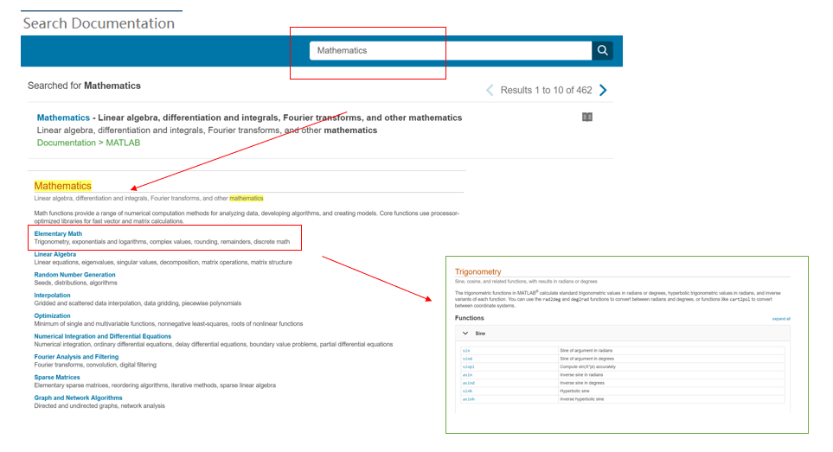
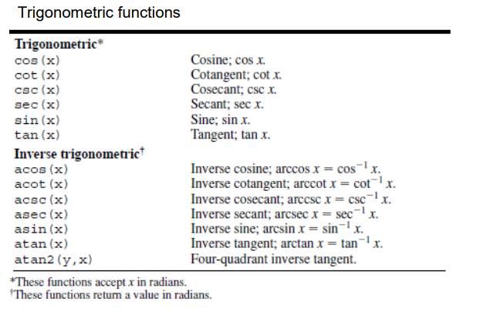
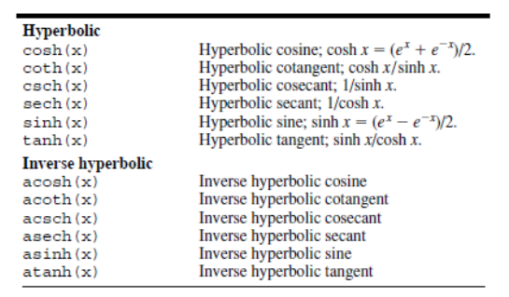
Matlab building function

Slide 8
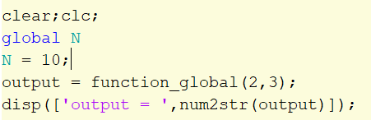
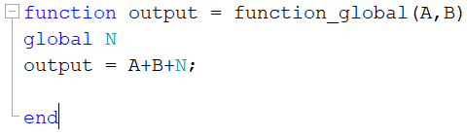
Function – global

Slide 9
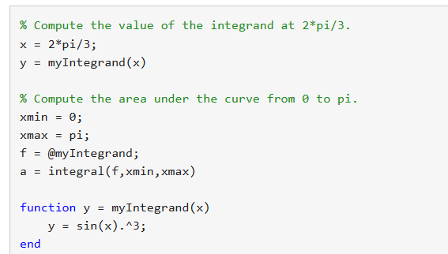

Slide 10
HOMEWORK

Slide 11
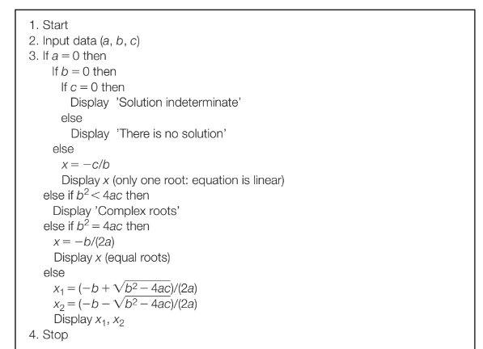

Slide 12
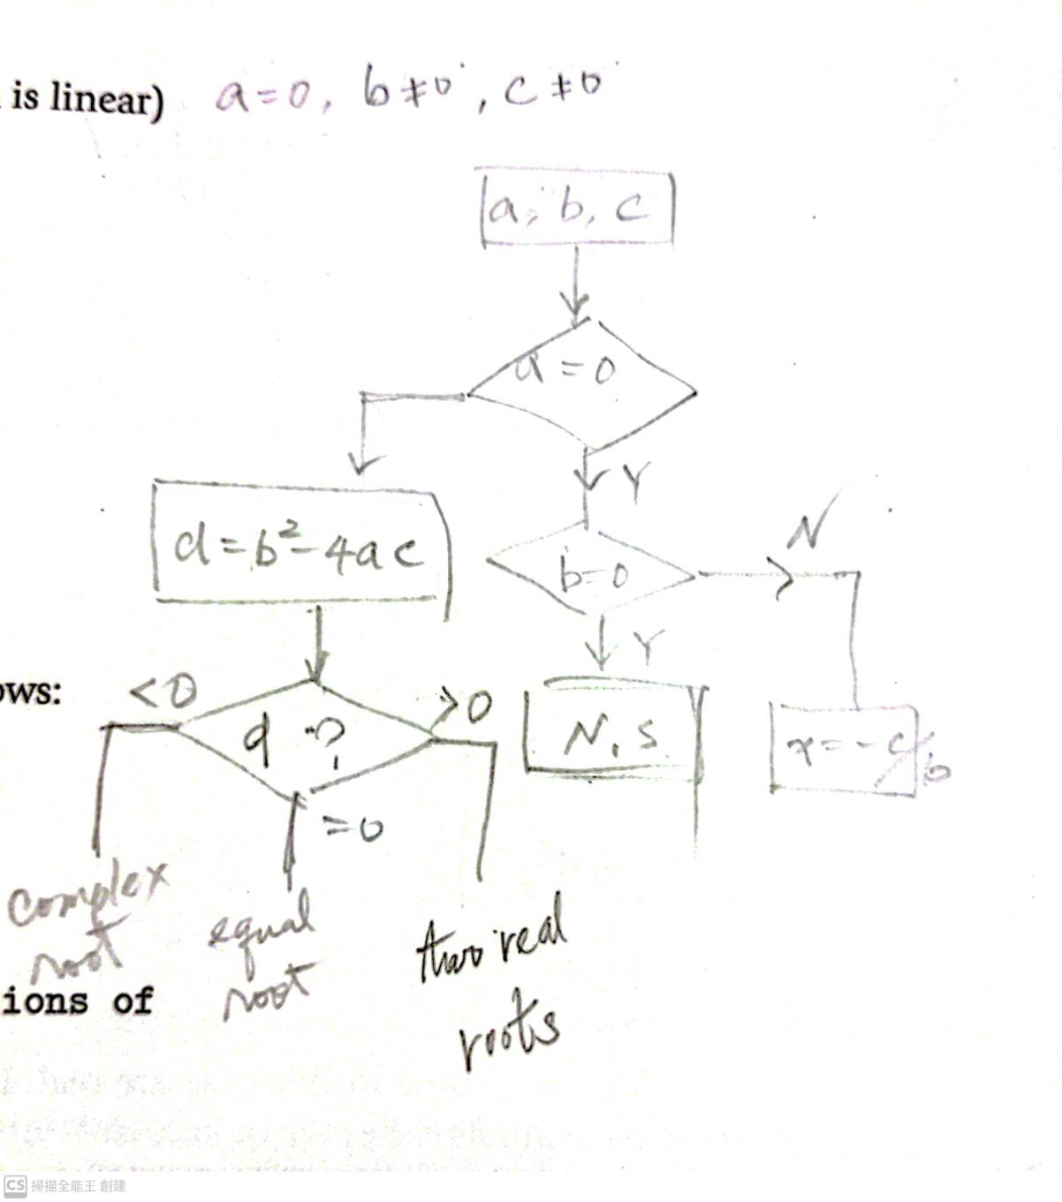

Slide 13
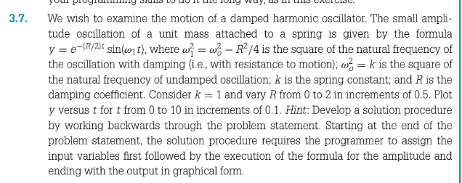

Slide 14

3. To write the following functions as the anonymous function

